Slide 1

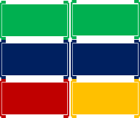
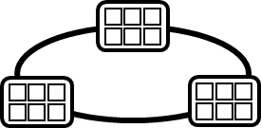
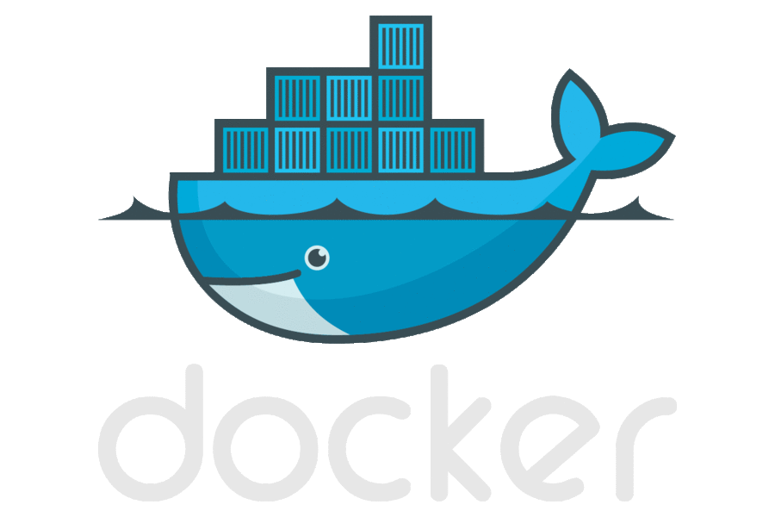



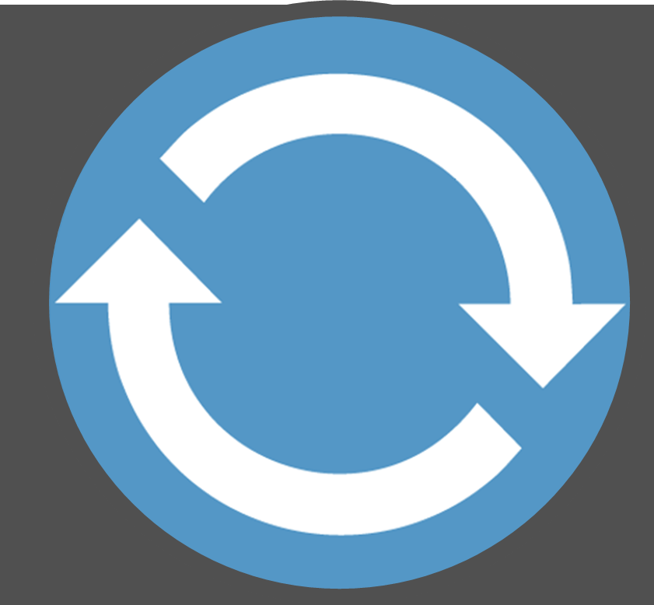
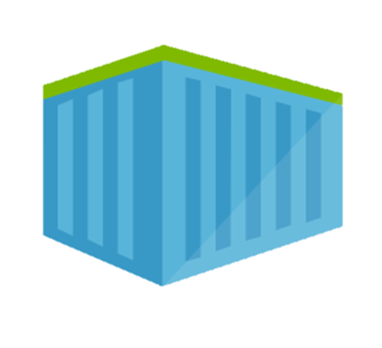
Containerized workflow
Container Service
2.
3.
4.
5.
Run, Manage
Service Fabric
Source Code Control
(SCC)
Build/CI,
Integrate,
Test
CD, Deploy
App Services
Production
environments
Common soon
Azure Container Registry
…
Push
code
…
Inner-Loop
6.
…
1.
Run
Azure Monitoring
Code
Validate
Debug
Outer-Loop
Notes:
When we look at the container continuous worfklows, we see containers and registries are a key concept.
We start with what we call the inner loop. Which is everything you do before you commit code.
From the beginning of your development cycle, you’re building and running your code in containers.
We pull base images from a container registry. Either Docker Hub, or perhaps our private corporate registry.
As we’re happy with our code, we commit the code to a source code repository.
The build system takes our code, a dockerfile that describes the build system and builds the collection of images I need for deployment
The images are pushed to our private registry, with the environment configurations extracted from the image.
When deployment happens, we pull images, add the environment information and push it out to various environments.
In Azure, we have many different container hosting offerings.
From Azure Container Service, which hosts the best of breed open source orchestrators
To Service Fabric, which can host guest containers
Or, Azure Batch, App Services for single container workloads that can scale.
And Azure continues to expand it’s container hosts as containers are becoming the unit of deployment.

Slide 2

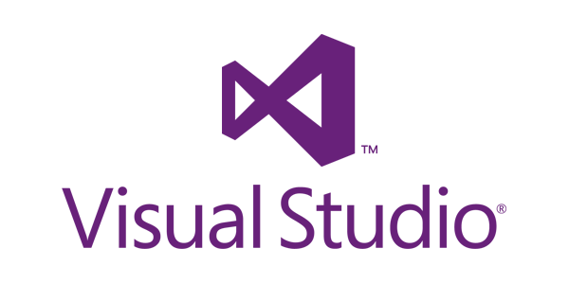
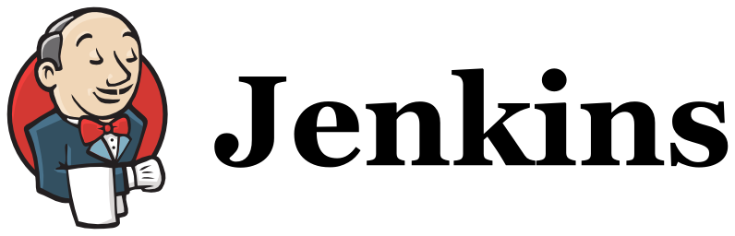
Microsoft Container Integrations
Language/ Framework
.NET
.NET Core
Node.js
GO
Java
Full FX
Core
Dev Tools
VS Code
IntelliJ
Build System
VSTS CI/CD
Target OS
Windows Server
Containers
Nano Server
Containers
Linux
Containers
Container Registry
Azure Container Registry
Secret Management
VSTS
Azure KeyVault, Hashicorp Vault
Container Hosting
App Services with Containers
ACS – Docker
ACS – Kubernetes
Service Fabric
ACS –DC/OS

Slide 3
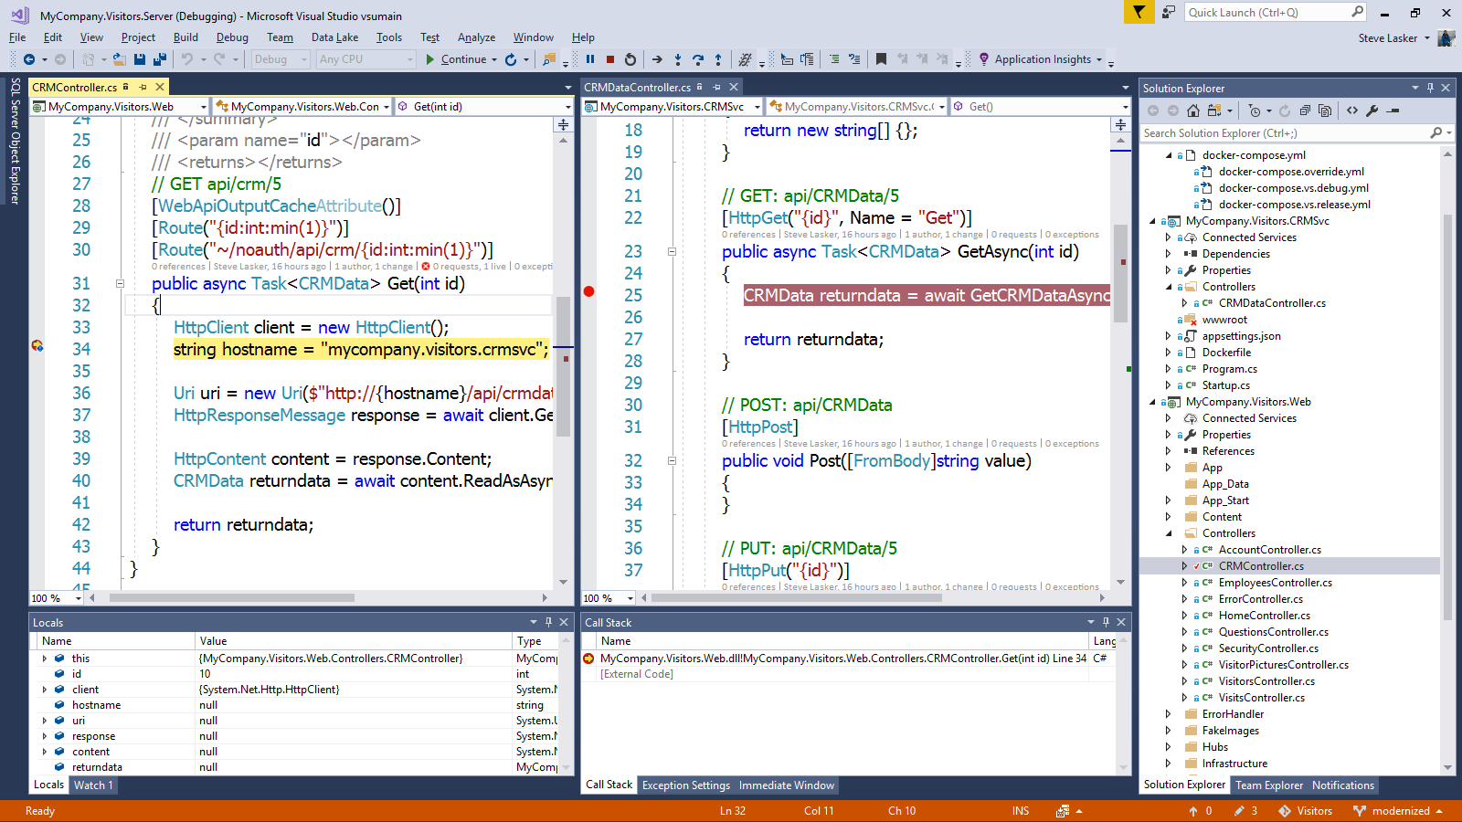
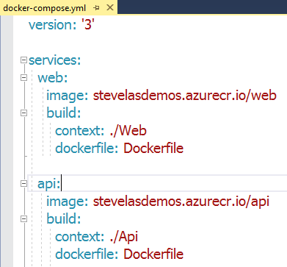
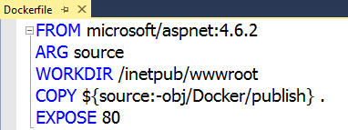
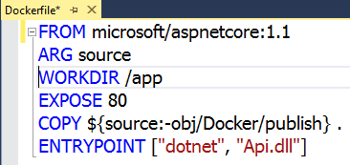
Visual Studio 2017 Container tools
Run, debug, test web, and console apps in Docker Containers
.NET FX w/Windows Server, .NET Core with Nano Server, and Linux
Breakpoint debugging
Edit & refresh of code
Scaffolds Docker assets
Dockerfile, docker-compose.yml

Slide 4
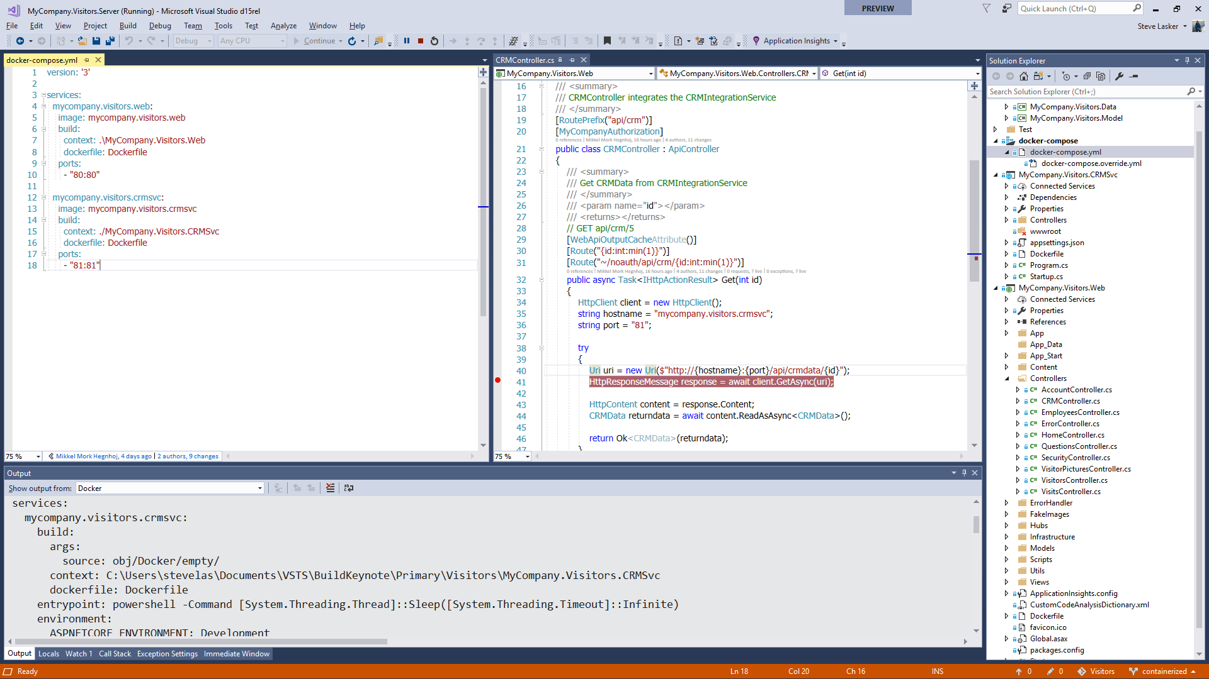
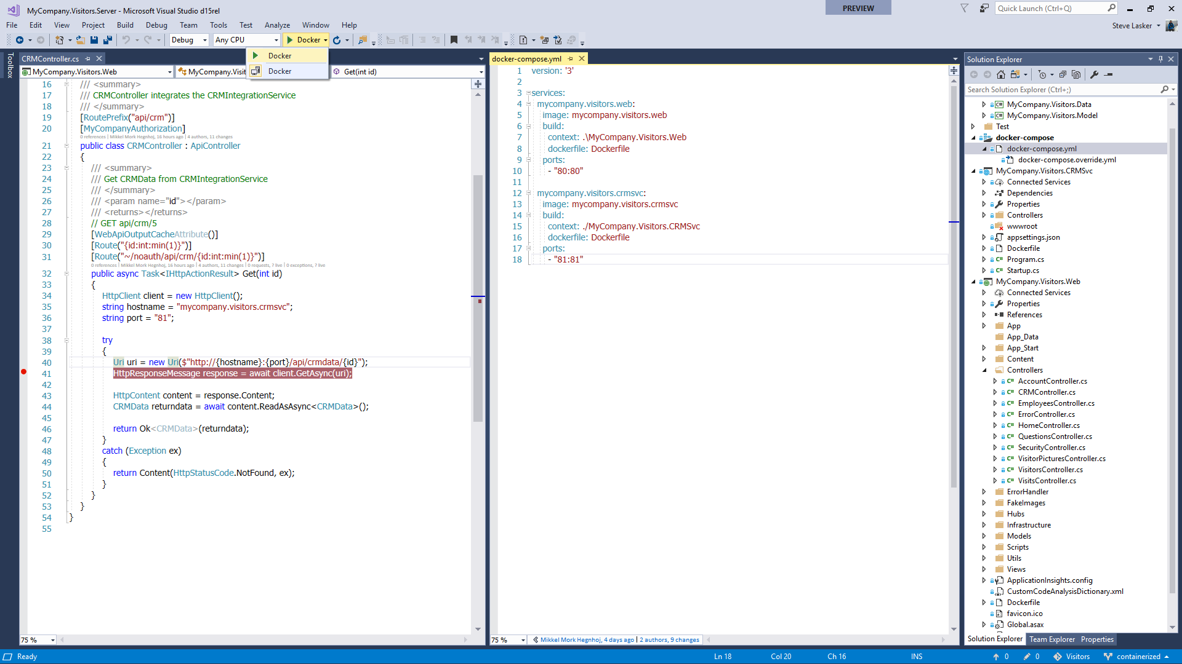
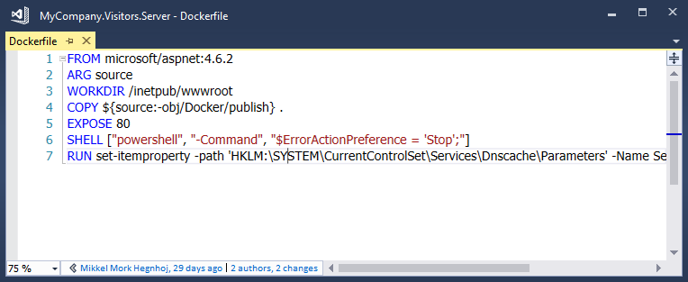
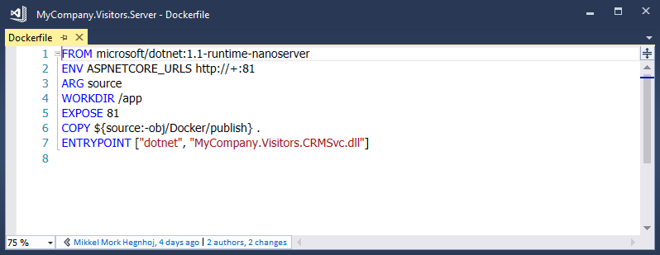
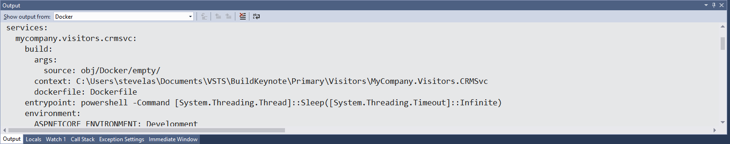

Slide 5
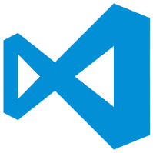
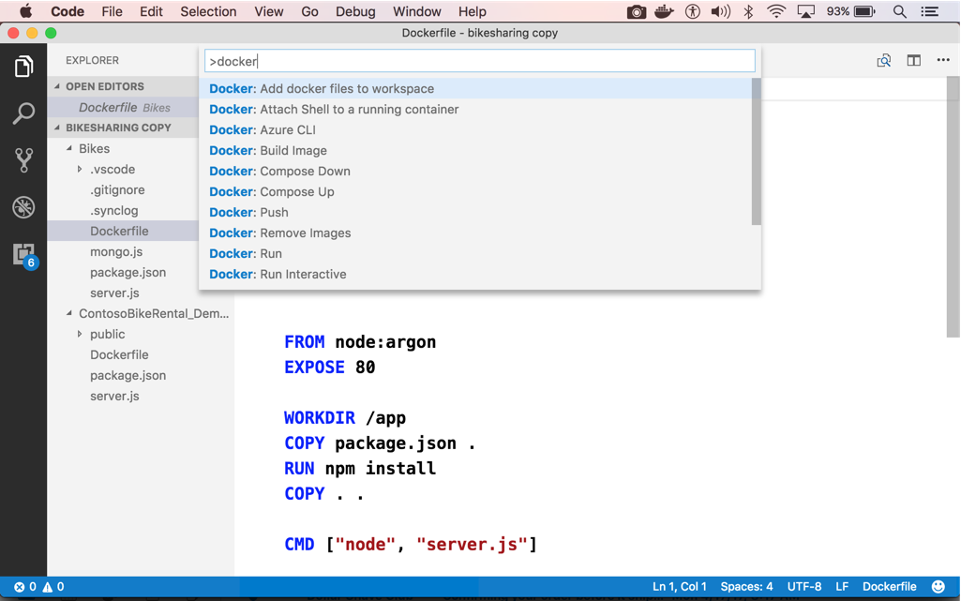
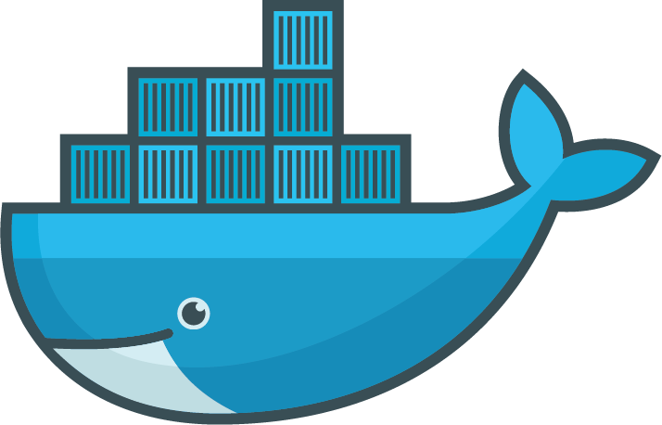
Visual Studio code
OS X, Linux, Windows
Node, Python, Go, .NET Core
Git SCC integration
Extensible platform
Docker Asset Editing – extension
aka.ms/VSCode
aka.ms/DockerToolsForVSCode

Slide 6
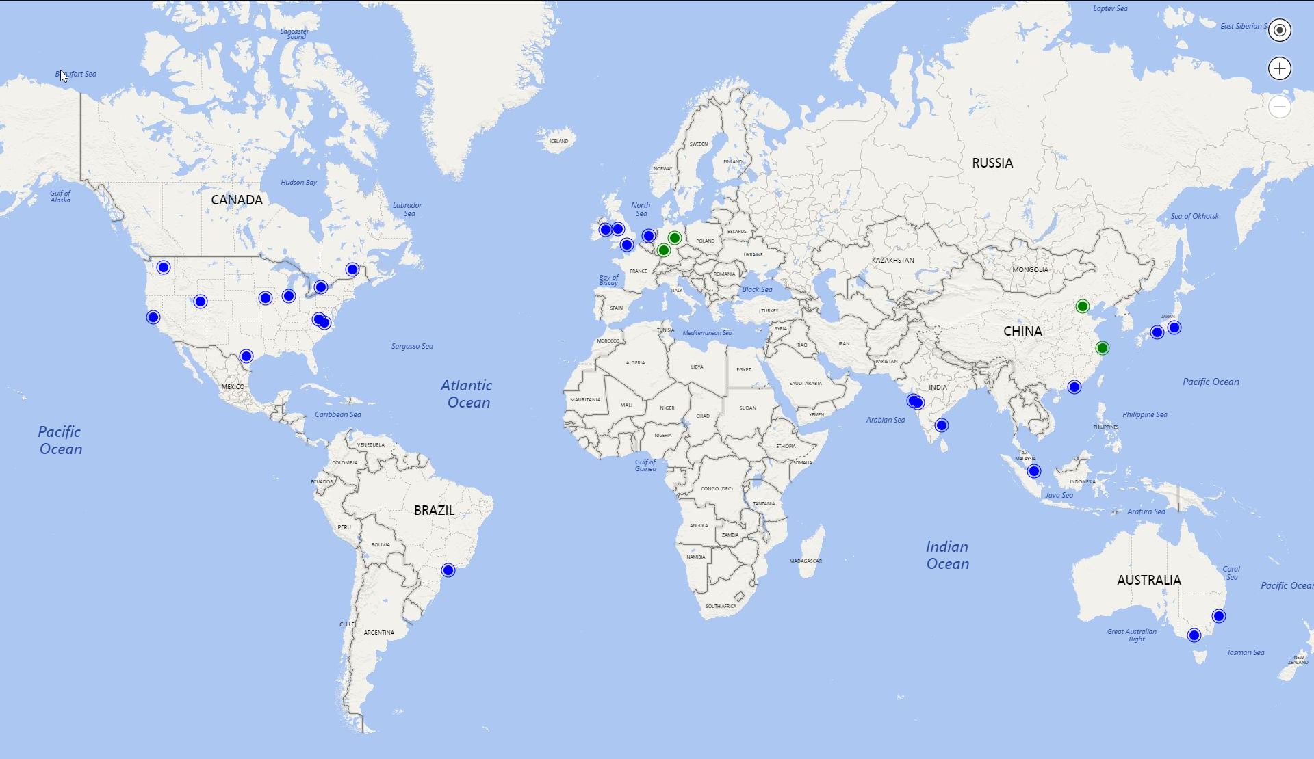

Azure Container Registry Global Coverage
All 23 public clouds
Australia East
Australia Southeast
Brazil South
Canada Central
Canada East
Central India
Central US
East Asia
East US
East US 2
Japan East
Japan West
North Central US
North Europe
South Central US
South India
Southeast Asia
UK South
UK West
West Central US
West Europe
West US
West US 2
Coming…
Sovereign clouds
Azure Stack
map.buildazure.com

